Slide 1
Encrypted Chat System using RSA Encryption
Chathura Kithmal
Brahmateja Musinana
Niraj Vachhani
Mahendra Vajja

Slide 2
Introduction
In an era defined by rapid technological advancements and seamless digital communication, ensuring the privacy and security of our conversations has become a paramount concern. As cyber threats loom large, safeguarding sensitive information from unauthorized access has never been more critical. In response to this pressing need, we proudly present the RSA-Encrypted Chat System - a cutting-edge solution that harnesses the power of asymmetric encryption to fortify your digital communications.

Slide 3
Requirements
Functional Requirements:
User Authentication: Users should be able to authenticate themselves to participate in the chat. This can be done through username/password, OAuth, or other secure authentication methods.
Send Encrypted Messages: Users should be able to send messages securely, with the messages encrypted using RSA encryption with their partner's public key.
Receive and Decrypt Messages: Users should be able to receive messages sent by their partner and decrypt them using their private key.
Chat Connection: The application should establish a connection between two users for secure communication.

Slide 4
Non- Functional Requirements:
Performance: The application should have low latency and respond quickly to user interactions. Encryption and decryption processes should be efficient to minimize processing delays. The application should be able to handle multiple users concurrently without significant performance degradation.
Maintainability: The codebase should be well-organized and maintainable. Modular design and code commenting should be employed to make it easier for developers to understand and modify the code.
Extensibility: The application should be designed with flexibility in mind, allowing for easy addition of new features in the future. New encryption algorithms or security improvements should be easily integrated.
Data Privacy: The application should adhere to data privacy laws and regulations. User data should be stored securely and not accessible to unauthorized individuals.

Slide 5
Logic behind the chat system:
Generate RSA Key pair with key size of 2048 bits.
Send server public key in PEM format to client.
Receive client public key in PEM format to Server.
Encrypt the message using RSA encryption with public key.
Decrypt the message using RSA encryption with private key.

Slide 6
Design and Implementation
Communication between the clients will be encrypted
Sending client will encrypt the chat and the receiving client will decrypt it
We are not send any clear text in between
3rd party who will be listening to the network will not be able to understand what they are chatting

Slide 7
Design and Implementation
Used Socket module, Threading Module
RSA external module
Import RSA library
Generate public and private keys with rsa.newkeys() method (Asymmetric encryption)
Encode the string to byte string
Then encrypt the byte string with the public key
Then the encrypted string can be decrypted with the private key.

Slide 8
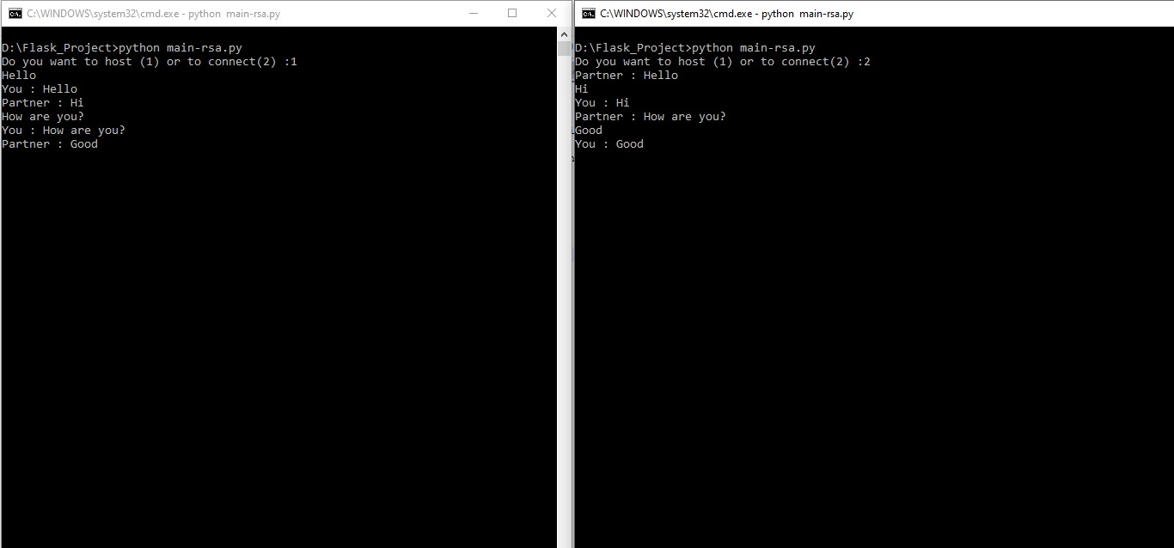
Secure Connection between Client and Server

